Slide 1
Classification Evaluation Metrics

Slide 2
Learning Objectives
By the end of this session, participants will be able to:
Understand why accuracy can be misleading in classification tasks
Interpret confusion matrices and error types (TP, TN, FP, FN)
Calculate and apply precision, recall, and F1-score effectively
Interpret ROC and Precision-Recall curves
Calibrate model probability outputs for reliability
Optimize decision thresholds based on business needs
Select the most appropriate evaluation metrics for a given problem

Slide 3
Introduction to Classification Evaluation Metrics
Evaluating a classification model goes beyond simply checking how many predictions are correct. While accuracy is often the first metric considered, it can hide important limitations, particularly when class distributions are imbalanced. A thorough assessment examines different aspects of model performance, including the types of errors made and their potential impact on business or operational decisions. Understanding these metrics is essential to make informed choices and optimize model outcomes effectively.

Slide 4
Why Accuracy Can Be Misleading
Scenario: Email Spam Detection
• 1000 emails: 950 legitimate, 50 spam (5% spam rate)
• Model that predicts 'not spam' for everything: 95% accurate!
• But catches ZERO spam emails
The Problem:
Accuracy doesn't account for class imbalance
Real-World Impact:
• Medical diagnosis: Missing rare diseases
• Fraud detection: Missing fraudulent transactions
• Quality control: Missing defective products

Slide 5
The Confusion Matrix
A confusion matrix is a table that summarizes the performance of a classification model by comparing predicted labels against the true labels. It clearly shows how many predictions were correct and how many were misclassified, distinguishing between true positives, true negatives, false positives, and false negatives. This framework provides the basis for calculating key evaluation metrics such as precision, recall, and F1-score, allowing for a deeper understanding of model behavior beyond simple accuracy.

Slide 6
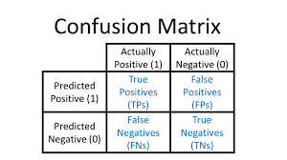
Confusion matrix
Key Concepts:
• TP: Correctly identified positives
• TN: Correctly identified negatives
• FP: False alarm (Type I Error)
• FN: Missed detection (Type II Error)

Slide 7
Understanding Error Types
Type I Error (False Positive)
Predicting positive when actually negative
Example: Healthy patient diagnosed with disease
"False alarm"
Type II Error (False Negative)
Predicting negative when actually positive
Example: Sick patient diagnosed as healthy
"Missed detection"

Slide 8
Precision
Minimizing False Positives
Measures the proportion of positive predictions that are actually correct
Answers: “Of all instances labeled positive, how many are truly positive?”
High precision → few false positives
Provides insight into the reliability of positive predictions
Precision = TP / (TP + FP)

Slide 9
When to prioritize precision
Precision should be prioritized when false positives are more costly or risky than false negatives.
This occurs in situations where incorrectly predicting a positive outcome can lead to wasted resources, unnecessary interventions, or operational issues.
High precision ensures that the model’s positive predictions are trustworthy and reliable.
Use cases for prioritizing precision include scenarios where erroneous positive predictions must be minimized, even if it means missing some true positive cases.
Deciding to prioritize precision requires understanding domain-specific consequences of false alarms and aligning model evaluation with business or operational objectives.

Slide 10
Recall (Sensitivity) Minimizing False Negatives
Measures the proportion of actual positive cases that are correctly identified
Answers the question, “Of all true positive instances, how many did the model successfully detect?”
High recall indicates the model makes very few false negative errors
Particularly important when missing positive cases carries serious consequences
Helps evaluate the model’s ability to capture all relevant instances in a dataset
Complements precision to provide a more complete understanding of model performance
Recall = TP / (TP + FN)

Slide 11
When to prioritize Recall
Recall should be prioritized when missing positive cases is more costly or dangerous than raising false alarms.
This is common in domains where failing to detect a true positive can lead to severe consequences or irreversible outcomes.
High recall ensures that the model captures as many true positive instances as possible, even if it increases false positives.
Prioritizing recall is appropriate when early detection, risk reduction, or coverage is more important than prediction precision.
Metric selection should reflect domain risk tolerance, regulatory requirements, and real world impact of missed cases.

Slide 12
The Precision-Recall Tradeoff
You Can’t Maximize Both
Precision and recall are inversely related, improving one often leads to a reduction in the other
Increasing the decision threshold typically improves precision but lowers recall
Decreasing the decision threshold typically improves recall but lowers precision
This tradeoff reflects the balance between minimizing false positives and minimizing false negatives
The optimal balance depends on domain requirements, business objectives, and risk tolerance

Slide 13
The Precision-Recall Tradeoff You Can't Maximize Both
The Dilemma:
• Increase precision → Decrease recall
• Increase recall → Decrease precision
Example: Medical Test
• Very strict threshold:
Few false positives (high precision)
Many false negatives (low recall)
• Very lenient threshold:
Few false negatives (high recall)
Many false positives (low precision)

Slide 14
F1-Score
The Harmonic Mean of Precision and Recall
Combines precision and recall into a single evaluation metric
Calculated as the harmonic mean, giving equal importance to both metrics
Produces a high value only when both precision and recall are high
Penalizes extreme imbalances where one metric is strong and the other is weak
Useful when a balanced tradeoff between false positives and false negatives is required
Provides a concise summary of model performance for imbalanced classification problems
F1 = 2 × (Precision × Recall) / (Precision + Recall)

Slide 15
When to Prioritize F1-Score
F1-score should be prioritized when both false positives and false negatives are important and neither can be ignored.
It is appropriate when the dataset is imbalanced and accuracy is not a reliable measure of performance.
F1-score is useful when a single summary metric is needed to compare models objectively.
It works best when precision and recall are considered equally important in decision-making.
F1-score is commonly used during model selection and benchmarking, before fine-tuning decision thresholds.

Slide 16
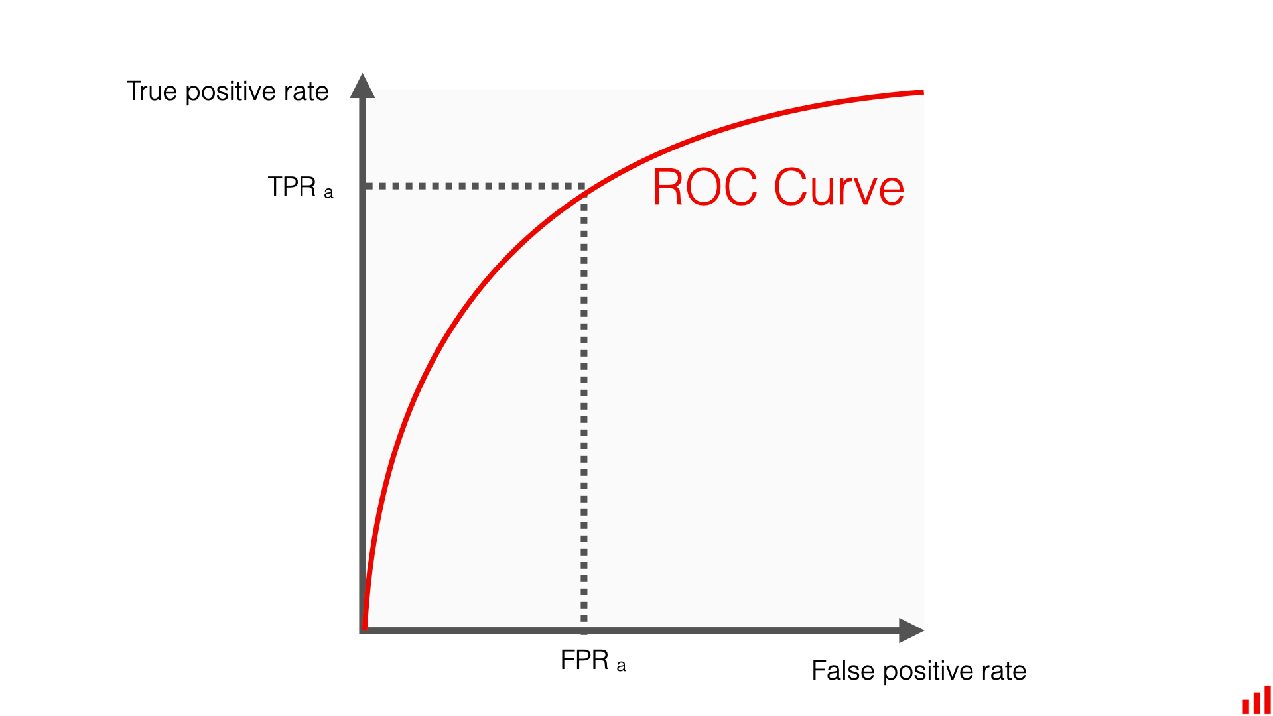
ROC Curve Receiver Operating Characteristic
Visualizes the tradeoff between the true positive rate and the false positive rate across different decision thresholds
Plots true positive rate (recall) on the y-axis against false positive rate on the x-axis
Illustrates how model performance changes as the classification threshold is adjusted
A curve closer to the top-left corner indicates better discriminatory performance
A diagonal line represents the performance of a random classifier

Slide 17
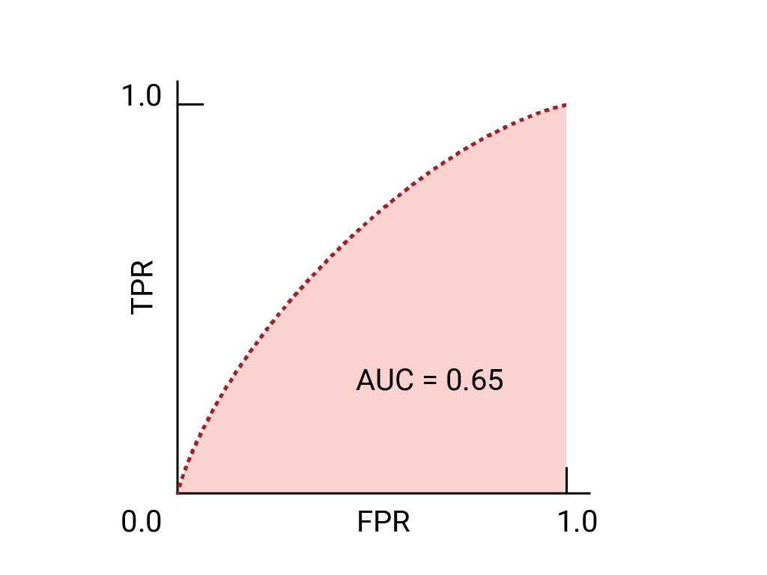
AUC - Area Under ROC Curve
Summarizes the performance of the ROC curve into a single numerical value
Measures the model’s ability to distinguish between positive and negative classes
Interpreted as the probability that a randomly chosen positive instance is ranked higher than a randomly chosen negative instance
Values range from 0.0 to 1.0, where higher values indicate better discriminatory power
An AUC of 0.5 represents random performance, while 1.0 indicates perfect classification
Enables objective comparison of different classification models

Slide 18
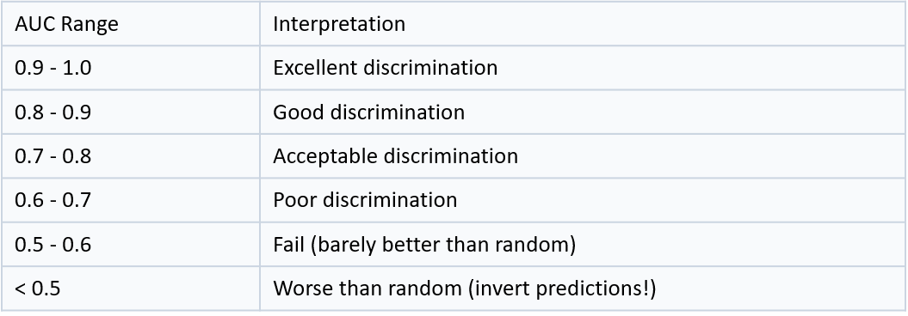
Single Number Summary
What It Measures: Probability that classifier ranks random positive higher than random negative

Slide 19
Precision-Recall Curves Better for Imbalanced Data
When to Use PR Curves:
• Highly imbalanced datasets
• Care more about positive class
• False positives are very costly
Why Better Than ROC:
• Not influenced by large number of true negatives
• Focuses on performance on minority class
• More informative for imbalanced problems
Use Cases:
Medical diagnosis, fraud detection, rare event prediction

Slide 20
Choosing the Right Metric Decision Framework
1. Is the dataset balanced?
Yes → Accuracy acceptable
No → Use precision, recall, F1, or AUC
2. Which error is more costly?
FP more costly → Maximize precision
FN more costly → Maximize recall
Both important → F1-score
3. Need single metric?
Balanced data → Accuracy or F1
Imbalanced data → PR-AUC or MCC
4. Business constraints?
Yes → Optimize threshold for business metric

Slide 21
Probability Calibration
Predicted probabilities may not reflect true likelihoods; calibration ensures predictions are reliable
Platt Scaling: Fits a logistic regression model to map scores to calibrated probabilities; simple and effective for small datasets
Isotonic Regression: Non-parametric approach that learns a flexible monotonic mapping; requires more data but can handle complex distributions
Decision Threshold Adjustment: Default threshold (0.5) may not be optimal; adjust based on business costs or risk tolerance
Optimizing thresholds can reduce costly misclassifications and align model outputs with operational objectives
Calibration and threshold tuning are critical when deploying models in real-world, high-stakes scenarios

Slide 22
Decision Threshold Optimization Beyond Default 0.5
Why Adjust Threshold:
• Default 0.5 rarely optimal
• Business costs are asymmetric
• Different operating points for different scenarios
Optimization Approaches:
1. Cost-Based: Minimize Cost(FP) × FP + Cost(FN) × FN
2. Business Metric: Maximize profit, minimize risk
3. Fixed Constraint: Achieve minimum recall, maximize precision
4. F-Beta Optimization: Optimize weighted F-score
Example: Fraud detection - Missing fraud costs $1000, false alarm costs $10

Slide 23
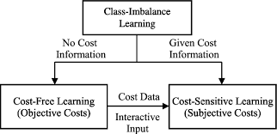
Cost sensitive analysis
Understanding the Real-World Impact of Errors
In many applications, not all errors are equally costly; some misclassifications can have serious financial, operational, or safety consequences
Standard evaluation metrics treat all errors equally, which may misalign model performance with business objectives
Cost-sensitive analysis explicitly accounts for the varying impact of false positives and false negatives
This approach ensures that model decisions reflect real-world priorities, making predictions actionable and aligned with organizational goals
Provides the foundation for techniques like threshold moving, class weighting, and custom loss functions

Slide 24
Cost-Sensitive Learning Techniques
Applying Business Priorities to Model Training
Threshold Adjustment: Move the decision boundary post-training to minimize costly misclassifications
Class Weights: Assign higher penalty to misclassifications of more critical classes during training
Sampling Methods:
Oversample minority class to reduce false negatives
Undersample majority class to reduce false positives
Custom Loss Functions: Directly incorporate business costs into the model’s optimization process
These techniques ensure model behavior aligns with real-world operational and financial priorities

Slide 25
Multi-Class Metric Aggregation
Macro, Micro, and Weighted Approaches
In multi-class problems, performance metrics must account for all classes and their distribution
Macro Averaging: Computes metric independently for each class, then averages; treats all classes equally
Micro Averaging: Aggregates contributions of all classes to compute a single metric; favors classes with more samples
Weighted Averaging: Averages metrics for each class, weighted by the number of instances; balances class importance and sample size
Choosing the right aggregation method depends on class distribution, business priorities, and whether all classes are equally important

Slide 26
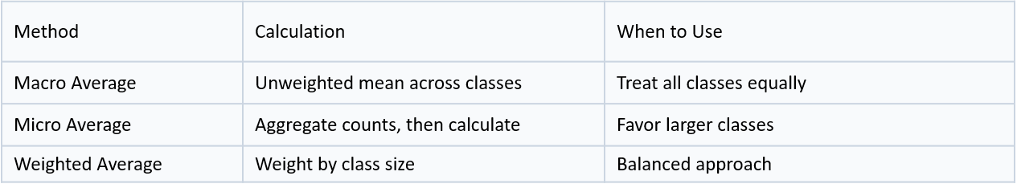
Multi-Class Metric Aggregation Macro vs Micro vs Weighted
Choose Based On:
• Class distribution in your data
• Business importance of each class
• Whether all classes matter equally

Slide 27
Matthews Correlation Coefficient Balanced Metric for Imbalanced Data
MCC evaluates the quality of binary classifications, taking into account true positives, true negatives, false positives, and false negatives
Range: -1.0 to +1.0
Interpretation:
• +1: Perfect prediction
• 0: No better than random
• -1: Total disagreement
Advantages:
• Works well with imbalanced classes
• Takes all confusion matrix elements into account
• Symmetric measure
MCC = (TP×TN - FP×FN) / √[(TP+FP)(TP+FN)(TN+FP)(TN+FN)]

Slide 28
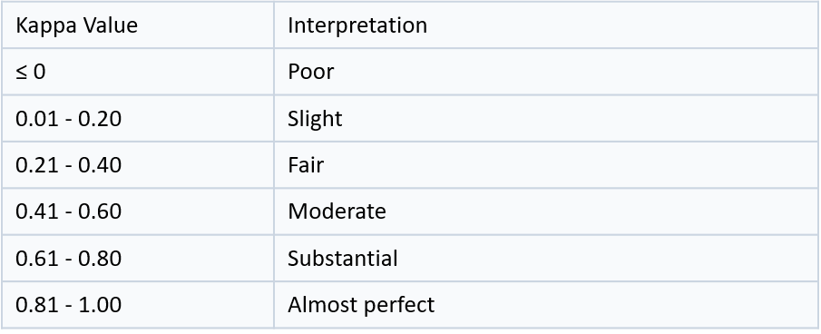
Cohen's Kappa Statistic Agreement Beyond Chance
Quantifies how much better a classifier performs compared to random chance

Slide 29
Case Study: Medical Diagnosis
Scenario: Cancer Screening Test
Priority: Maximize Recall (catch all cases)
Why:
• FN (missing cancer) = life-threatening
• FP (false alarm) = additional tests, manageable
Metrics to Track:
• Primary: Recall (must be ≥ 95%)
• Secondary: Precision (optimize within recall constraint)
• Monitor: F2-score (recall-weighted)
Threshold Decision:
Lower threshold to 0.3 → Recall 98%, Precision 65%

Slide 30
Case Study: Email Spam Filter
Scenario: Email Classification System
Priority: Maximize Precision (avoid blocking important emails)
Why:
• FP (blocking important email) = critical business impact
• FN (letting spam through) = minor annoyance
Metrics to Track:
• Primary: Precision (must be ≥ 95%)
• Secondary: Recall (optimize within precision constraint)
• Monitor: F0.5-score (precision-weighted)
Threshold Decision:
Raise threshold to 0.85 → Precision 99.5%, Recall 75%

Slide 31
Common Mistakes to Avoid
1. Using Accuracy on Imbalanced Data
→ Always check class distribution first
2. Optimizing Threshold on Test Set
→ Use validation set, then apply to test set
3. Ignoring Business Costs
→ Always align metrics with business objectives
4. Not Calibrating Probabilities
→ Calibrate before deployment if using probabilities
5. Choosing Metrics Before Understanding Problem
→ Understand business context first, then select metrics
6. Relying on Single Metric
→ Report multiple metrics for comprehensive view

Slide 32
Metric Selection Flowchart
Balanced Classes?
YES
NO
Use: Accuracy, F1
Which Error Costlier?
FP → Precision
FN → Recall
Always consider: PR-AUC, ROC-AUC, MCC for imbalanced data

Slide 33
Monitoring Metrics in Production
Key Principles:
1. Track Multiple Metrics
Don't rely on single metric - monitor precision, recall, F1
2. Set Alert Thresholds
Define acceptable ranges (e.g., Recall < 85% triggers alert)
3. Monitor by Segment
Track metrics across different user groups, time periods
4. Re-calibrate Periodically
Data distribution shifts - recalibrate probabilities quarterly
5. A/B Test Threshold Changes
Test new thresholds on subset before full deployment

Slide 34
Tools for Metric Calculation
Scikit-learn Metrics:
• classification_report - Comprehensive metrics table
• confusion_matrix - Confusion matrix generation
• roc_auc_score, roc_curve - ROC analysis
• precision_recall_curve - PR curve plotting
• calibration_curve - Probability calibration assessment
Visualization Libraries:
• Matplotlib - Custom plots
• Seaborn - Confusion matrix heatmaps
• Plotly - Interactive metric dashboards
Best Practice: Create reusable evaluation functions

Slide 35
Practice Exercise
Scenario: Credit Card Fraud Detection
Dataset:
• 100,000 transactions
• 500 fraudulent (0.5% fraud rate)
Business Costs:
• Missed fraud (FN): $500 average loss
• False alarm (FP): $25 investigation cost
Your Tasks:
1. Which metric should be primary?
2. What threshold would you choose?
3. Calculate expected cost at different thresholds
4. Would you use ROC-AUC or PR-AUC? Why?

Slide 36
Key Takeaways
Accuracy can be misleading on imbalanced datasets; always check class distribution
Precision vs. Recall: Choose based on which type of error (false positive or false negative) is more costly
F1-Score balances precision and recall when both are important
ROC and AUC visualize and summarize model performance across thresholds
Precision-Recall Curves are more informative for highly imbalanced datasets
Probability calibration and threshold adjustment ensure predictions align with business priorities
Cost-sensitive learning incorporates real-world error costs into model evaluation
Advanced metrics (MCC, Cohen’s Kappa) provide robust evaluation for imbalanced or multi-class problems

